Slide 1
Engineering Computing I
Chapter 1 – Part A
A Tutorial Introduction

Slide 2
C is a general-purpose programming language
C is not a ‘‘very high level’’ language
C was originally designed for UNIX

Slide 3
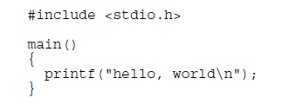
Getting Started
Print the words: hello, world

Slide 4
How to execute a program? (Step 1- Editing)
Create and edit a ‘C’ source file
Open a Command/Terminal Window
Use an “Text Editor”
Create the file “hello.c”
Enter the ‘C’ code
Save the file with a desirable path

Slide 5
How to execute a program? (Step2 - Compilation)
Compile the source file:
Compile the source file “hello.c” using a ‘C’ Compiler such as Microsoft ‘cc.exe’ compiler or GNU for your machine (Windows32, MAC or Linux)
Use the right compiler switches
The compiler produces an object file (binary machine code) → “hello.bin”

Slide 6
How to execute a program? (Step3 - Linking)
Link the source file to other object files:
Link the object file “hello.bin” with the library files available in your machine using “link.exe” or similar programs.
Library files are collections of pre-compiled relocate-able basic functions or API’s.
The Linker produces an executable binary file (machine code) → “hello.exe”

Slide 7
Integrated Development Environment (IDE)
In the IDE GUI environment:
Enter and edit the source file
Set Compiler and Linker switches
Build →Compile & Link
Run → Execute file in a command window
Debug the file:
Watch Variables
Single Step
Go to a braekpoint

Slide 8
Code Blocks
Open source IDE
Windows, MAC and Linux Versions
Use GNU compiler/Linker
Other IDEs:
Microsoft Visual C++
Borland
WATCOM
etc.

Slide 9
Code::Blocks IDE
Pull-Down
Menu
Text Editor
Pull-Down
Menu
Logs , Reports, etc.
Multi-Tab Windows

Slide 10
Your First C Program!
Launch CodeBlocks in your machine
Using Tool Bars:
Carefully type in “Hello, World” program in a new C file. Save it as “hello.c”
Build it. If any errors, correct and rebuild.
Run The program.
Repeat the above using icons.

Slide 11
Analysis of Program
Functions

Slide 12
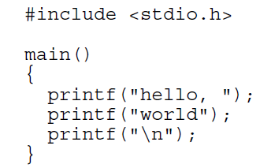
Variations to “hello, World”

Slide 13
Exercise ‘Formatted List’
Write a program using escape characters ‘\b’, ‘\t’, ‘\n’, etc. to generate the following print out:
Number Name Age
-------------------------------
1 John 20
2 Adam 18
3 Michael 20
Separate using tabs
Save your program as: ‘FormattedList.c’

Slide 14
Exercise ‘Large Letters’
Write a program using escape characters ‘\b’, ‘\t’, ‘\n’, etc. to print out large letters (A, B, …):
*
**
***
* *
* *
Save your program as: ‘LargeLetter.c’

Slide 15
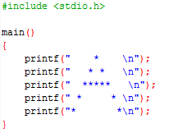
Solution toExercise ‘Large Letters’

Slide 16
Variables and Arithmetic Expressions

Slide 17
Variables and Arithmetic Expressions
Pseudo Code for Fahrenheit to Celsius Conversion Program:
lower= 0; step = 20; upper = 300
fahr = lower;
while fahr <= upper
{
celsius = (5/9)*(fahr-32)
print far and celsius
}

Slide 18
Binary Arithmetic Operations
Operation | Symbol
Addition | +
Subtraction | -
Multiplication | *
Division | /

Slide 19
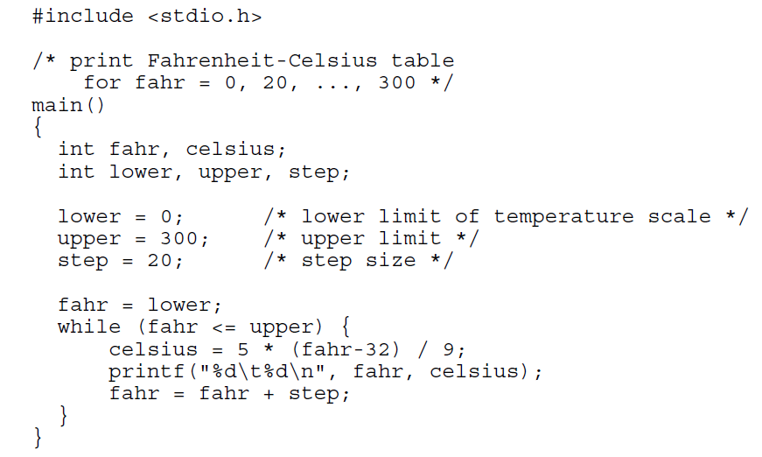
Fahrenheit to Celsius

Slide 20
Tutorial on Numbers: Signed & Unsigned Integers
Whole Numbers: 1, 2, 3, …
Whole Numbers plus 0: 0, 1, 2, 3, …
Whole Numbers with Positive or Negative Signs plus 0: …, -3, -2, -1, 0, 1, 2, 3
Unsigned Integers
Unsigned Integers

Slide 21
Tutorial on Numbers: Signed & Unsigned Integers
4-bit example
unsigned
signed
0, 1, 2, …, 2⁴ - 1
-2³ , -2³ + 1,…, -1, 0, 1, …, 2³ - 1
0
0
0
0
0
8
1
0
0
0
0
0
0
0
0
-8
1
0
0
0
1
0
0
0
1
9
1
0
0
1
1
0
0
0
1
-7
1
0
0
1
2
0
0
1
0
10
1
0
1
0
2
0
0
1
0
-6
1
0
1
0
3
0
0
1
1
11
1
0
1
1
3
0
0
1
1
-5
1
0
1
1
4
0
1
0
0
12
1
1
0
0
4
0
1
0
0
-4
1
1
0
0
5
0
1
0
1
13
1
1
0
1
5
0
1
0
1
-3
1
1
0
1
6
0
1
1
0
14
1
1
1
0
6
0
1
1
0
-2
1
1
1
0
7
0
1
1
1
15
1
1
1
1
7
0
1
1
1
-1
1
1
1
1

Slide 22
Tutorial on Numbers: Signed & Unsigned Integers - Size
char → 8 bits
Small size int → short int
Medium Size → int
Large Size → long int

Slide 23
Tutorial on Numbers: Example: size on 32-bit machine
char → 8 bits
short int → 16 bits
int → 32bits
long int → 32 bits

Slide 24
Tutorial on Numbers: Examples on 32-bit machine
 | Unsigned | Signed
Char | 0 .. 2⁸ -1 | -2⁷ .. 2⁷-1
 | 0 .. 255 | -128 .. 127
int | 0 .. 2¹⁶⁻¹ | -2¹⁵ .. 2¹⁵-1
 | 0 .. 65535 | -32768 .. 32767
long | 0 .. 2³² -1 | -2³¹ .. 2³¹-1
 | 0 .. 4294967295 | -2147483648 .. 2147483647

Slide 25
Exercise
Find the signed and unsigned ranges for 64-bit integers
A ‘C’ Compiler is to be designed for a 4-bit microprocessor. Come up with relevant sizes for the following types:
char
int
long

Slide 26
Floating Point
The IEEE Standard for Floating-Point Arithmetic (IEEE 754) is the most widely-used standard for floating-point computation
(−1)^{s} × c × 10^{q}
^{Example:}
^{S=1}
^{c=12345}
^{q=-3}
⁼ ^{-12.345}

Slide 27
Float, double
Name | Common name | Base | Digits | E min | E max
binary32 | Single precision | 2 | 23+1 | -126 | +127
binary64 | Double precision | 2 | 52+1 | -1022 | +1023

Slide 28
Testing Different Sizes
Using ‘sizeof()’ function, write a short program to determine the size of different types of variables on your machine.

Slide 29
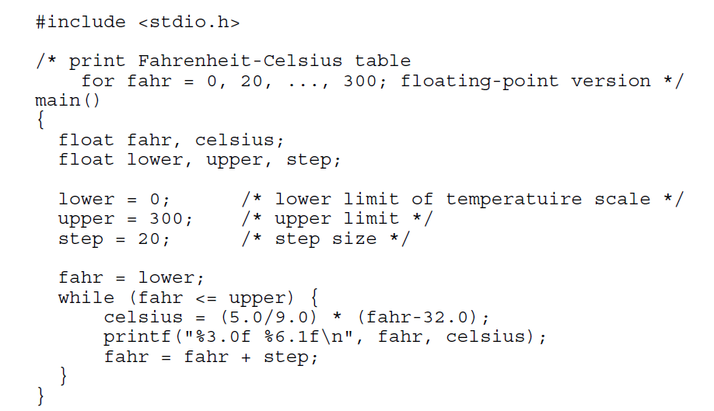
Fahrenheit to Celsius More Accuracy

Slide 30
Width & Precision

Slide 31
Exercises

Slide 32
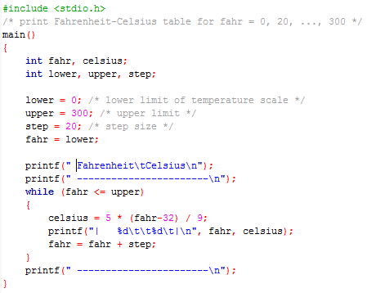
Solution toExercise 1.3

Slide 33
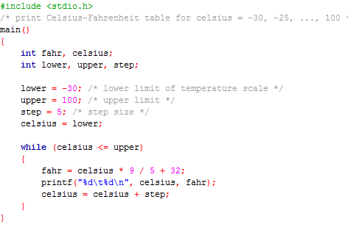
Solution to Exercise 1.4

Slide 34
The ‘For’ Statement
Body of Loop
Initialization
Condition
Increment

Slide 35
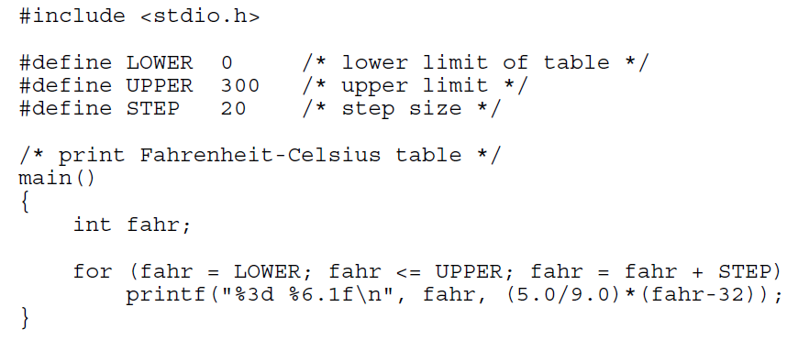
Symbolic Constants

